Slide 1
PHA501 Graduation Project
2024-2025
01/11/2024

Slide 3
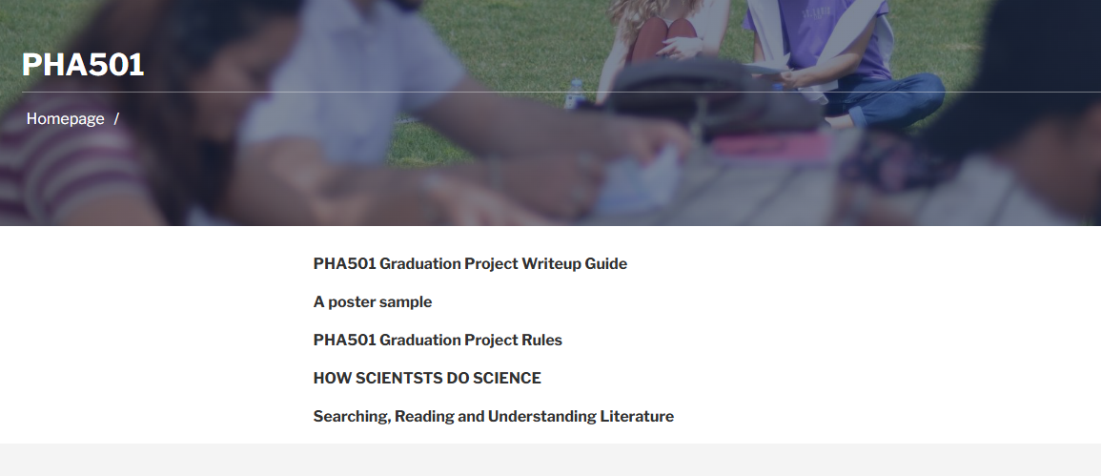
://eczacilik.neu.edu.tr/pha501/?lang=en

Slide 4
Rules…
1. PHA501 is an annual course, and students must select just one PHA501 Graduation Project advisor; you must choose it on the UZEBIM first and then the Genius system. Otherwise, student selection on Genius will not be taken into consideration.
2. The PHA501 advisor and student will decide the topic of the PHA501 Graduation Project.
3. When students write their PHA501 Graduation project thesis, they must use academic research platforms like PubMed, Web of Science, Google Scholar
4. The graduation writeup guide is available from this link;
5. http://eczacilik.neu.edu.tr/resources/?lang=en, students have to use this writeup guide.ar, etc. or
Criteria %
The PHA501 advisor assessment - Thesis 60%
The average of all advisor assessments - Poster presentation 40%
The students must apply the research ethics principle to avoid plagiarism.
The PHA501 advisor and graduation project committee will control the similarity test of the PHA501 Graduation Thesis. The similarity of the thesis could be a maximum % of 40. Otherwise, the Graduation Project will not be accepted by the Graduation Project Committee.

Slide 5
Deadlines…
Poster Submission; 17/01/2025
The poster presentation will be face-to-face; the graduation project committee will announce the method of presentation and deadline during the Fall term.
The poster presentation will be marked as;
Speech and knowledge: 10%
Replying questions: 10 %
Punctuality (Time): 10%
Quality of slides and text, richness in pictures: 10 %
PHA501 Graduation Project Submission; 31/01/2025
Student should get their supervisor approval first and they need to get hard copy and send their thesis to nephar501@neu.edu.tr.

Slide 7
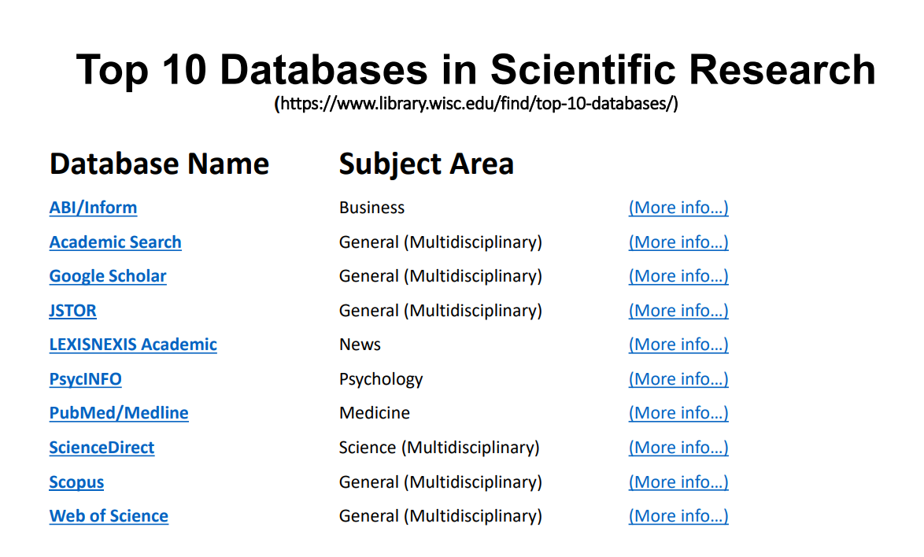

Slide 9
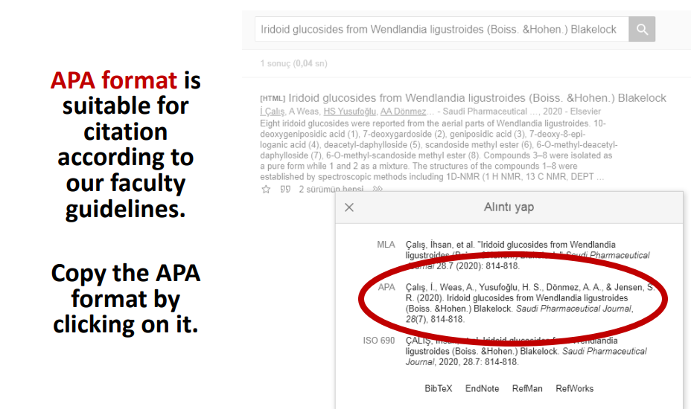

Slide 10
Do not hesitate to ask any questions to your PHA501 Graduation Project Supervisor.
Thanks for your attention!
PHA501 Graduation Committee

